Slide 1
A Seminar on Detection of Phishing Websites
Team Details
K. Vaishnavi(20eg105120)
P. Shilpa(20eg105139)
S. Naveen(20eg105143)
CH. Uday Goud(20eg105718)
Project Supervisor
Dr. K. Shailaja
Assistant Professor

Slide 2
Introduction
Phishing is a form of cyber attack where malicious actors attempt to deceive individuals into providing sensitive information, such as usernames, passwords, financial details, or other personal information, by posing as a trustworthy entity. This is typically done through fraudulent emails, messages, or websites that mimic legitimate ones.
In order to avoid getting phished,
• users should have awareness of phishing websites.
• have a blacklist of phishing websites which requires the knowledge of website
being detected as phishing.
• detect them in their early appearance, using machine learning.
Applications
Threat Intelligence Platforms
Web Browser Integration
Network Security Appliances

Slide 3
Literature
Author(s) | Strategies | Advantages | Disadvantages
A.Alswailem B.Alabdullah N.Alrumayh A. Alsedrani | The authors identify pertinent features, such as URL length, the presence of suspicious keywords, use of frames, and website age, among others, to develop a comprehensive understanding of potential indicators of phishing. Subsequently, the project delves into model selection and training, employing various machine learning algorithms, including Naive Bayes, Support Vector Machines (SVM), and Artificial Neural Networks (ANNs). These algorithms undergo training on labeled datasets encompassing examples of both phishing and legitimate websites, each contributing distinct strengths and weaknesses concerning accuracy and interpretability. The trained models are then employed for website classification based on the extracted features, and their performance is rigorously assessed using metrics like accuracy, precision, and recall. | Automating phishing detection saves resources and scales efficiently, reducing human effort and potential biases. | The model's effectiveness relies heavily on the quality and comprehensiveness of the training data. Biases within the data can be propagated by the model.

Slide 4
Literature
Author(s) | Strategies | Advantages | Disadvantages
A. Razaque M. B. H. Frej D. Sabyrov A. Shaikhyn F. Amsaad A. Oun | The project's foundation is built upon collecting a lot of data, including both fake and real websites. Using a list of known fake websites, called a blacklist, the project carefully filters these websites. It looks at important details like text, links, images, and web addresses from both fake and real websites. After that, the project focuses on understanding and sorting these details using machines and learning techniques, especially things like Natural Language Processing and sentiment analysis. This helps find patterns in the language and spot suspicious content that might mean a website is trying to trick people. The project combines this understanding with information from the blacklist to teach a machine how to tell if a new website is real or fake. To make all this useful for regular users, the authors create a Chrome extension, which is like a little tool that works with the Chrome web browser. This tool uses the machine learning model to quickly check websites while people are browsing. If it thinks a website might be fake, it warns the user, making the internet safer for everyone. | Combining blacklist filtering with ML-powered semantic analysis offers a layered defense against phishing, increasing the chances of catching both known and novel scams. | Running real-time analyses within a browser extension might pose certain resource constraints, particularly on older devices.

Slide 5
Literature
Author(s) | Strategies | Advantages | Disadvantages
M. H. Alkawaz S. J. Steven A. I. Hajamydeen | the authors skillfully design an extensive set of features, considering various aspects of websites such as URL length, suspicious keywords, hosting IP addresses, website age, and even visual features like font sizes, colors, and layouts using image processing techniques. Moving to model selection and training, a diverse ensemble of machine learning algorithms, including Decision Trees, Random Forests, and Support Vector Machines (SVMs), is employed and trained on datasets labeled with both phishing and legitimate websites. This ensemble approach aims to capitalize on the strengths of different algorithms, enhancing overall accuracy and robustness. Feature selection and model optimization follow, involving statistical analysis to identify the most relevant features. The trained models undergo further optimization to refine their performance, minimizing false positives and negatives. To make their findings accessible to users, the authors design a user-friendly interface in the user interface and deployment phase. | Incorporating visual features like font styles and layouts adds a unique dimension to the analysis, enabling detection of phishing attempts that rely on visual mimicry. | Phishing techniques constantly evolve, making it crucial to continuously update the training data and potentially retrain the models to maintain accurate detection capabilities.

Slide 6
Problem Statement
As online activities grow, so does the risk of phishing websites, which pose a serious threat to user information and online security. This project aims to create a smart system using machine learning to detect phishing websites more effectively. The challenge is that phishing techniques are getting more advanced, requiring sophisticated algorithms to spot subtle signs of malicious intent in website links. The goal is to go beyond traditional security methods by using machine learning to quickly check if a website is safe. This involves building a good dataset, extracting important features, and creating a user-friendly interface. Success in this project means improving user security by promptly identifying and warning users about potential dangers, contributing to a safer online experience.

Slide 7
Proposed Method
Gather a dataset comprising both phishing and legitimate websites from open source platforms.
Clean and preprocess the dataset
Extract relevant features from the URLs (e.g., URL length, depth, presence of HTTPS) .
Evaluate the model's performance on the testing dataset using metrics such as accuracy.
Develop a user-friendly front-end using a web framework
Integrate the trained machine learning model into the front-end application.
Display the prediction result on the front-end

Slide 8
DATA COLLECTION
Legitimate URLs are collected from the dataset provided by University of New Brunswick, https://www.unb.ca/cic/datasets/url-2016.html.
From the collection, 5000 URLs are randomly picked.
Phishing URLs are collected from open source service called PhishTank . This service provide a set of phishing URLs in multiple formats like csv, json etc. that gets updated hourly.
Form the obtained collection, 5000 URLs are randomly picked
Department of Computer Science and Engineering

Slide 9
FEATURE SELECTION
The following features are selected:
• Address Bar based Features
• Domain based Features
• HTML & Javascript based Feature
Address Bar based Features considered are:
• Domain of URL
• Redirection ‘//’ in URL
• IP Address in URL
• ‘http/https’ in Domain name
• ‘@’ Symbol in URL
• Using URL Shortening Service
• Length of URL
• Prefix or Suffix "-" in Domain
• Depth of URL
Department of Computer Science and Engineering

Slide 10
FEATURE SELECTION
Domain based Features considered are:
DNS Record
Age of Domain
Website Traffic
End Period of Domain
HTML and JavaScript based Features considered are:
Iframe Redirection
Disabling Right Click
Status Bar Customization
Website Forwarding
Department of Computer Science and Engineering

Slide 11
MACHINE LEARNING MODELS
This project involves a supervised machine learning task, falling into the category of classification problems. In this context, the goal is to classify input URLs as either phishing (1) or legitimate (0). The machine learning models selected for training in this notebook specifically focus on classification techniques.
These models include
Decision Tree
Random Forest
XGBoost
Department of Computer Science and Engineering

Slide 12
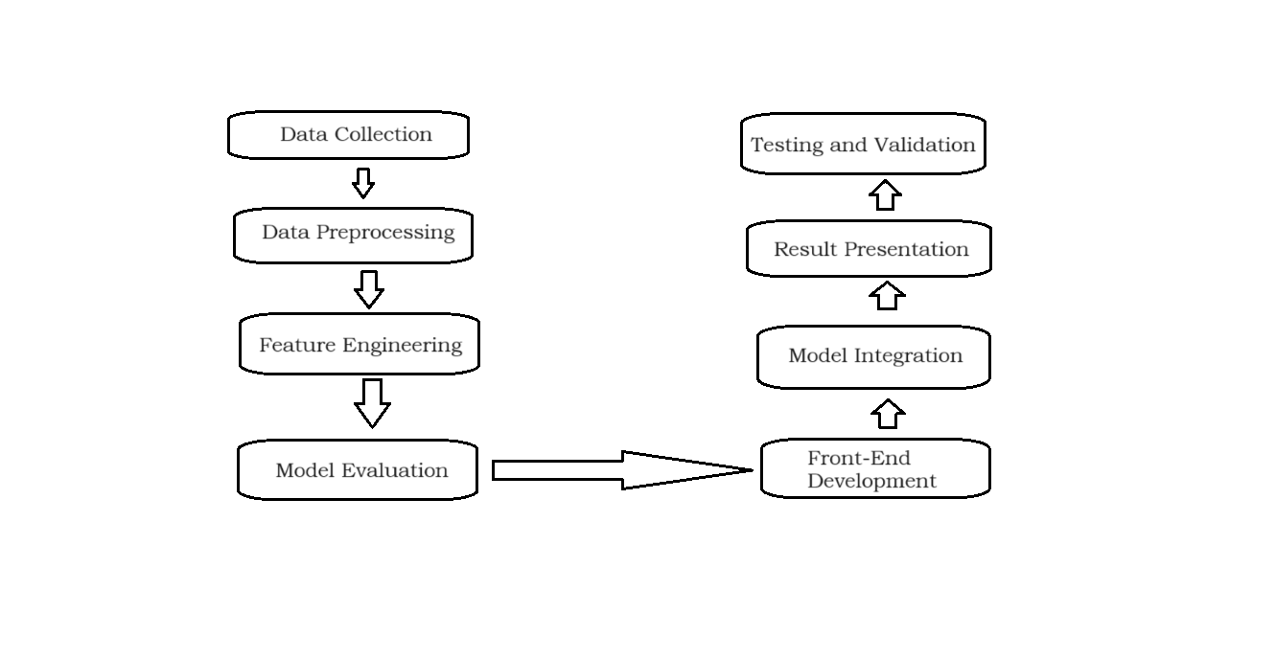
Proposed Method Illustration

Slide 13
Experiment Environment
Tool: Visual Studio Code
Language: Python
Dataset: Comma-separated values file
list of columns in dataset are Domain, Have_IP, Have_At, URL_Length, URL_Depth, Redirection, https_Domain, TinyURL, Prefix/Suffix, DNS_Record, Web_Traffic, Domain_Age, Domain_End, iFrame, Mouse_Over, Right_Click, Web_Forwards, Label.

Slide 14
Project status
S.No | Functionality | Status (Completed /in-progress/Not started)
1 | Data Collection | Completed
2 | Feature Extraction | In-progress
3 | Model Training | Completed
4 | Front-end Development | In-progress
5 | Model Integration | Not Started

Slide 15
References
[1]. Alswailem, A., Alabdullah, B., Alrumayh, N., & Alsedrani, A. (2019). Detecting Phishing Websites Using Machine Learning. 2019 2nd International Conference on Computer Applications & Information Security (ICCAIS).
[2]. Razaque, A., Frej, M. B. H., Sabyrov, D., Shaikhyn, A., Amsaad, F., & Oun, A. (2020). Detection of Phishing Websites using Machine Learning. 2020 IEEE Cloud Summit.
[3]. Alkawaz, M. H., Steven, S. J., & Hajamydeen, A. I. (2020). Detecting Phishing Website Using Machine Learning. 2020 16th IEEE International Colloquium on Signal Processing & Its Applications (CSPA).

Slide 16
Thank you

Slide 17
Project seminar–I Evaluation
S.No | Rubrics | Marks
1 | Concept Introduction | 4
2 | Literature and Parameter | 5
3 | Problem and Problem Illustration | 8
4 | Proposed Method and Illustration | 8
Total |  | 25

